Slide 1
Interagency Council on Homelessness
Full Council Meeting
17 October 2023

Slide 2
Convention for Recording ICH Full Council Meetings:
Recording for purposes of complying with the Open Meeting Act requirements
Available for anyone who requests a copy at ich.info@dc.gov.
2

Slide 3
Meeting Agenda
Welcome and Opening Remarks (5 mins)
Public Comments (20 mins)
Discussion on Adopting a Winter Plan (60 mins)
Background/Basics of the Plan (10 mins)
Understanding the Updates to the Winter Plan (30 mins)
Action (Consensus or Vote) to Adopt (10 mins)
The Future of Hypothermia Planning (10 mins)
Public Comments Continued (time permitting)
Summary & Adjournment (5 mins)

Slide 4
Welcome & Opening Remarks
Moment of Silence
Recognition & Thanks
Housekeeping –Attendance to Confirm Quorum

Slide 5
Recognition
Support for the 10/17 ICH Full Council Meeting
DOES for hosting and
N Street Village for light refreshments
Support drafting/updating the Winter Plan
ICH Committee/Workgroup | Co-Chairs | ICH Advisor
Emergency Response & Shelter Operations CMTE | Reginald Black, PFFC & Anthony Newman, DHS | Synina Pugh
Shelter Capacity WG | Michael Ferrell, Coalition for the Homeless | Synina Pugh
Shelter Solutions WG | Amanda Chesney, Catholic Charities & Shaquin Grier, DHS | Synina Pugh
Front Door Services WG | TBD | Eileen Rosa

Slide 6
Attendance: Quorum Requirements
Category | Quorum Requirements | Present
DC Gov Reps | At least 6 of 16 members | 14
Service Provider Reps | At least 2 of 6 members | 4
Advocates, Business Sector, & Lived Experience | At least 4 of 10 members | 6

Slide 7
Attendance –DC Gov Representatives
 | Government Representatives | Present
1 | City Administrator, Chair | Y
2 | Deputy Mayor for Health and Human Services | Y
3 | Interagency Council on Homelessness | Y
4 | Department of Human Services | Y
5 | Department of Behavioral Health | Y
6 | Child and Family Services Agency | Y
7 | Department of Housing and Community Development | N
8 | Department of Health | Y
9 | DC Housing Authority | Y
10 | Department of Corrections | Y
11 | Department of Employment Services | Y
12 | Office of the State Superintendent of Education | Y
13 | Homeland Security and Emergency Management Agency | Y
14 | Department of General Services | Y
15 | DC Metropolitan Police | Y
16 | Office of LGBTQ Affairs | N
Subtotal of Gov Reps |  | 14
Quorum (Defined in Bylaws as 1/3 of 16 = 5.33) |  | 6

Slide 8
Attendance –Community Representatives
 | Category | Name | Present
1 | Provider | Christy Respress, Pathways | Y
3 | Provider | Jean-Michel Giraud, Friendship Place | Y
3 | Provider | Koube Ngaaje, DASH | N
4 | Provider | Amanda S Chesney, Catholic Charities | Y
5 | Provider | Kelly S McShane, Community of Hope | Y
6 | Provider | Kenyatta T Brunson, N Street Village | N
Subtotal of Providers |  |  | 4
Quorum (Defined in Bylaws as 1/3 of 6 = 2) |  |  | 2
 | Category | Name | Present
1 | Advocate | Adam Rocap, Miriam’s Kitchen | Y
2 | Advocate | Debby Shore, Sasha Bruce Youthworks | N
3 | Advocate | Karen Cunningham, Everyone Home DC | Y
4 | Advocate | Kate Coventry, DC Fiscal Policy Institute | Y
5 | Business Sector | Tonia Wellons, Great Washington Community Foundation | N
6 | Business Sector | Catherine Crosland, Unity Healthcare | Y
7 | Business Sector | Shellon Fraser, National Housing Trust | N
8 | Lived Experience | Aaron White, ICH SHY Youth Advisory Board | N
9 | Lived Experience | Qaadir El-Amin | Y
10 | Lived Experience | Reginald Black | Y
Subtotal of Advocates, Business Sector & Lived Experience Constituents |  |  | 6
Quorum (Defined as 1/3 of 10 = 3.3) |  |  | 4

Slide 9
Notes on Welcome & Opening Remarks
…

Slide 10
Meeting Agenda
Welcome and Opening Remarks (5 mins)
Public Comments (20 mins)
Discussion on Adopting a Winter Plan (60 mins)
Public Comments Continued (time permitting)
Summary & Adjournment (5 mins)

Slide 11
Public Comments Guidelines
Due to limited time and to accommodate as many public comments as possible
Comments are limited to 2 mins per person &
Comments will not be addressed during the Public Comments period.
Thank you in advance for your understanding!

Slide 12
Notes on Public Comments
Michael Lee: Concern on actions and communication from several agencies over the last 30 years and specifically related to COVID and Dr. Anthony Fauci. Frustration on misuse and abuse of positions in government.
Jarroda Kelsaw: ERAP program was closed within 10 days. As someone who wanted to apply, this is detrimental. Reminder that this needs to be addressed.

Slide 13
Notes on Public Comments
Ms. Umi: Want to bring the name Adam Zarincalaki who was unsheltered at Petworth library. He died Feb 2023 and was matched to a voucher in July 2022. His name will be honored at the vigil this year. You are working on this issue and appreciate the work, but the bottleneck persists, and it is taking too long. Want to raise Adam’s name. Libraries should be a safe space.
Rachelle Ellison: Want to honor the name of Leo Colter who passed. He was also matched to a voucher. I join you passionately in outreach and this work. We need to make ways to properly bury and memorialize those who lose their lives while experiencing homelessness.

Slide 14
Meeting Agenda
Welcome and Opening Remarks (5 mins)
Public Comments (20 mins)
Discussion on Adopting a Winter Plan (60 mins)
Background/Basics of the Plan (10 mins)
Understanding the Updates to the Winter Plan (30 mins)
Action (Consensus or Vote) to Adopt (10 mins)
The Future of Hypothermia Planning (10 mins)
Public Comments Continued (time permitting)
Summary & Adjournment (5 mins)

Slide 15
Background/Basics of the Plan
While a lot has changed, rest assured our core commitment says the same!
Purpose
Timing
Alert Status
Alert Process

Slide 16
Background/Basics of the Plan
Purpose | Protect from inclement weather and prevent cold weather injury By mobilizing critical, life-safety resources
Timing | November 1 to March 3
Inclement Weather Alerts | Hypothermia Alert Temp plus windchill forecasted to be 32°F or below OR Temp plus windchill forecasted to be 40 °F or below AND the change of precipitation is 50% or greater Cold Weather Alert 15˚F or below (including wind chill) or 20˚F (including wind chill), and one or more of the following conditions exists: Steady precipitation for 60 consecutive minutes Snow accumulation of 3 inches or more Other meteorological conditions or threats as determined by HSEMA
Process | Daily consultations with National Weather Service (NWS) by 7 am and by 3 pm DHS and HSEMA determination to establish alerts based on consultations DHS email alert to Provider Network; HSEMA email alert via Alert DC Additional notices and alerts as described in the Winter Plan

Slide 17
Notes on Winter Plan Background/Basics
…

Slide 18
Meeting Agenda
Welcome and Opening Remarks (5 mins)
Public Comments (20 mins)
Discussion on Adopting a Winter Plan (60 mins)
Background/Basics of the Plan (10 mins)
Understanding the Updates to the Winter Plan (30 mins)
Action (Consensus or Vote) to Adopt (10 mins)
The Future of Hypothermia Planning (10 mins)
Public Comments Continued (time permitting)
Summary & Adjournment (5 mins)

Slide 19
Understanding the Winter Plan Updates
This is the first post-pandemic Winter Plan & pandemic recovery resources are demobilizing or no longer available!
Timeline
Changes

Slide 20
Understanding the Winter Plan Updates
TIMELINE
Draft reviewed by ERSO CMTE | Approved by consensus with condition at 09/27 ERSO CMTE meeting To address comments and integrate feedback from the meeting discussion
Updated Draft Circulated to Full Council | Integrates feedback and comments from ERSO CMTE circulated last week to Full Council Flags new concerns surfaced during the process of integrating comments
Additional Updates | Submitted by partners since the updated draft was circulated Discussed at 10/12 Shelter Solutions WG meeting Itemized here for final review and approval

Slide 21
Understanding the Winter Plan Updates
CHANGES BY SIGNIFICANCE & SECTION
Most Significant Updates | Limited reliance on DPR Recreational Centers Pandemic recovery resources are demobilizing or no longer available (e.g., ISAQ & PEPV) Shelter densities are steadily increasing across the system
Other Significant Changes | Deployment of warming buses Expansion of services (e.g., DHS launched Front Door Navigation Tool and DBH expanded detoxification providers available)
Changes by Section | Introduction –tweaked for references to COVID-19, MPX, & OMS §2. Process for Calling Alerts – standard template for communicating shifts recommended §3. Emergency Shelter – most significant changes captured here; final updates flagged §4. Transportation Schedule – minimal changes; final updates flagged by partners §5. Service Coordination – updates to align language to actual activities (e.g., meals) and reflect the expansion of services; final updates flagged by partners §6. Unaccompanied Minors & TAY – updates to align with actual activities

Slide 22
Understanding the Winter Plan Updates
CHANGES TO ADDRESS ERSO CMTE CONCERNS
09/27 ERSO CMTE Concerns & Requests | ICH Updates
Evaluate timing of overflow for men and women | Capacity at the start and the height of the hypothermia season called out
Double check the model for families | Model for family shelter updated With current shelter census data and At a 25% surge in entries for families
Clarify transportation around | Type, Description, and hours Immediate contact for escalating concerns Final updates flagged by partners
Include outstanding COVID-19 concerns and appropriate forum for follow up | Plan details list of outstanding concerns and recommends that the Proposed Health Care Committee tackle COVID-related concerns so ERSO CMTE can focus on tracking the implementation of the Winter Plan
MPD Role in Transportation | Removing references to MPD in voluntary transportation to detox services This is also a final update flagged by MPD.

Slide 23
MOST SIGNIFICANT CHANGES

Slide 24
Minimizing Reliance on DPR Rec Centers
Challenges to reliance on Rec Centers
Historically, contested by the immediate community
Critical for violence prevention efforts among youth and young adults
Significant effort to expand hours of operations late into evenings (9:30 pm) creates conflict with hours for overflow locations (7 pm – 7 am)
Strategy for minimizing the use of Rec Centers
Leveraging Apt Style Family Shelters (Naylor Road)
Partnering with Faith-Based/Mission-Driven Orgs (Salvation Army, Church of the Epiphany & Faith United Church of Christ)
Repairing Federal City Shelter (North 1)

Slide 25
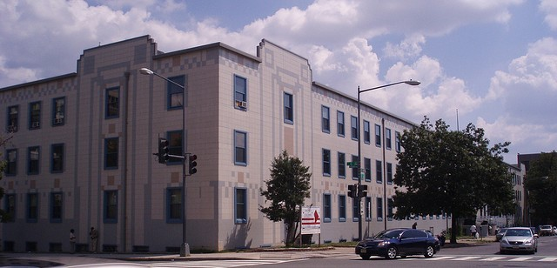
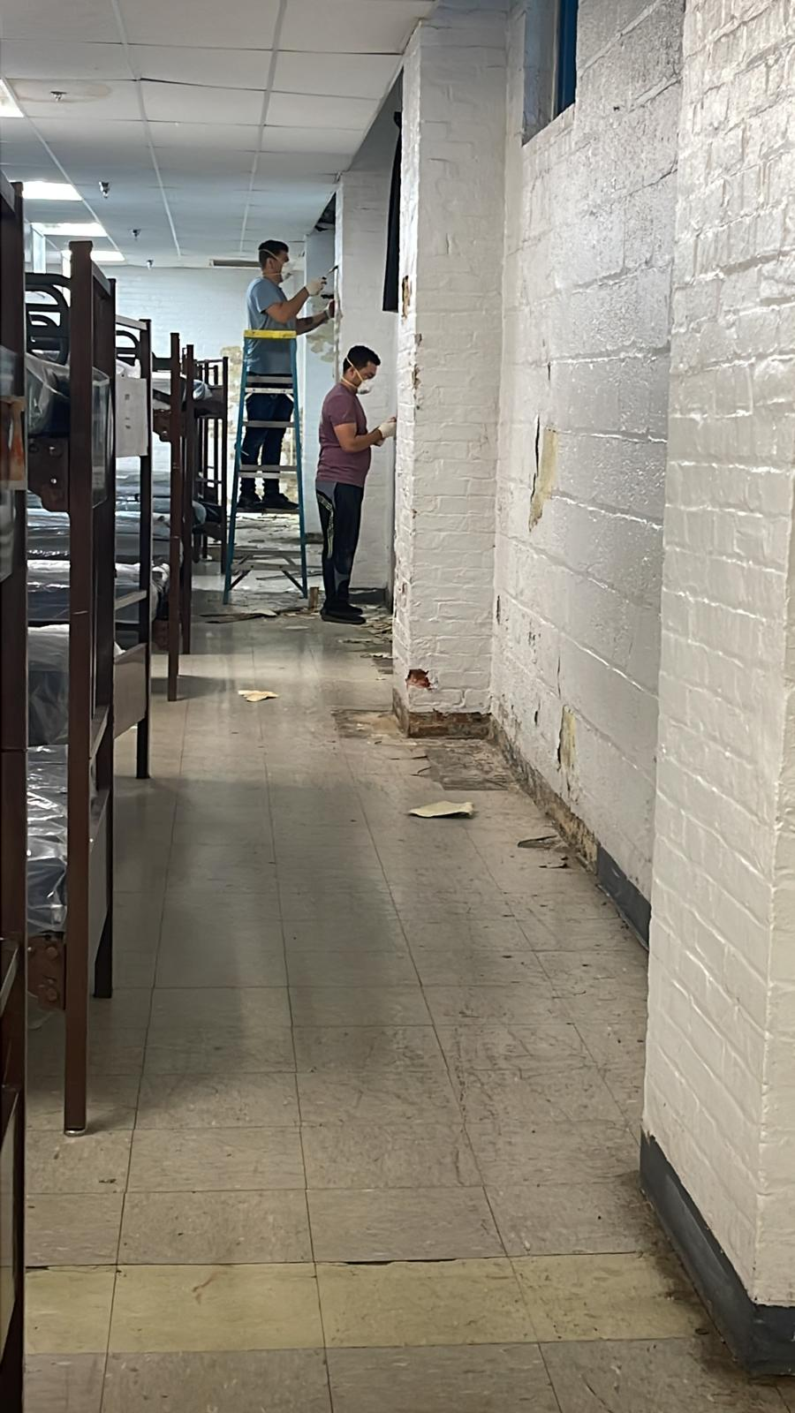
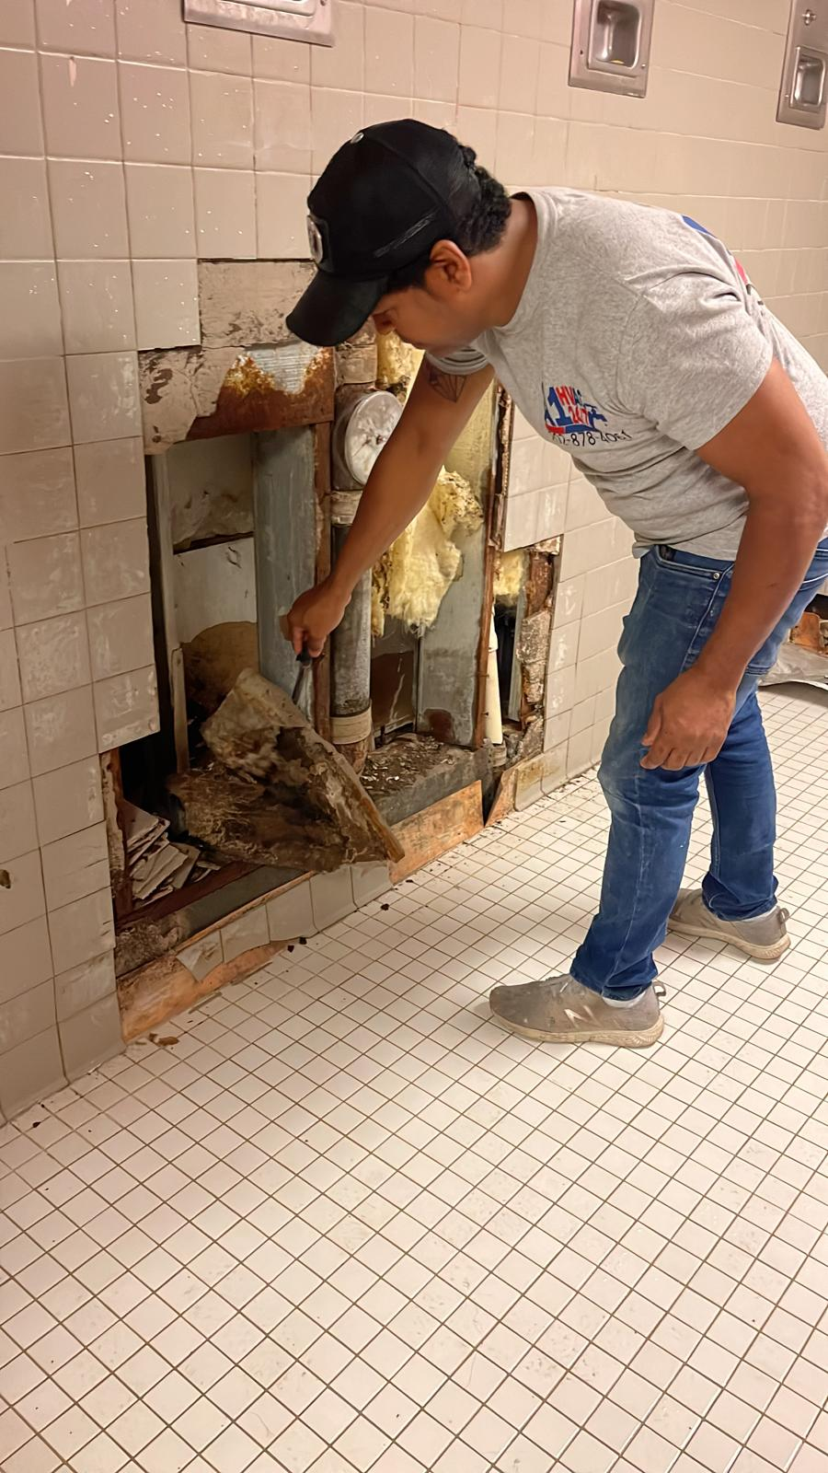
Leveraging Federal City Shelter (CCNV) 1 North:
Federal City Shelter (Hypothermia Repairs)
One North – Capacity for 200 residents.
One South (Drop-In-Location) – Capacity for 130 residents.
Remediation Services:
Currently, $1.2M has been provided for plumbing and lighting repairs for Section 1 North and 1 South and HVAC performance covering the entire Federal City Shelter.
Contractors are on-site performing necessary repairs.
Expected delivery date of Mid/Late December 2023
Completed Actions:
Exterior Wall Overhead Protection – To manage the risk of tiles falling to the ground from the upper portion of the building.

Slide 26
FAQs - Federal City Shelter (CCNV) 1 North:
Q: How much funding is dedicated to this project?
A: Approximately $1.2M is needed for plumbing and lighting repairs for Section 1 North and HVAC performance covering the entire Federal City Shelter.
Q: Has the funding been secured?
A: DGS has secured the funding needed.
Q: What is the timeline for construction?
A: Expected delivery date is Mid/Late December 2023
Q: Is there a buffer built into the 60-day projection?
A: DGS is familiar with the site and the work that needs to be done. Contingency is in place for unforeseen conditions and long-lead items.
Q: Is this work expected to be impacted by supply chain issues?
A: DGS does not anticipate delays due to the supply chain.
Q: Can DGS provide assurances of the repairs?
A: DGS will address other areas as they move and work in space. The intent is to ensure that the space is livable and dignified.
Q: What does the work entail?
A: HVAC repair is the focus, though it may include additional repairs related to lighting and bathroom areas to ensure the space is livable and dignified.
Q: What parts of the building need repair?
A: Work is focused on necessary repairs for using space this hypothermia season.
Q: Is it possible to open certain sections of the shelter while repair work is underway?
A: During HVAC repairs, CCNV will be open. DGS will work with DHS to assess a phase-in approach with the intent to have all construction activity completed by Mid/Late December 2023.
Q: Will the condition of this work and the building support the volume of individuals planned for the site in the immediate and long term?
A: DGS is tracking additional site needs and will procure vendors to be on call for emergencies.

Slide 27
Preparation and Maintenance for Hypothermia Season:
Heating Systems: Ensure heating systems are in good working order.
Emergency Generators: Maintain backup generators in case of power outages.
Snow Removal: Have a plan for snow and ice removal from walkways and parking areas.
Weather Monitoring and coordination with DHS: Stay informed about weather forecasts and prepare accordingly.
Training: Train staff on cold weather safety procedures and response protocols.
Communication: Establish communication channels for emergencies and updates.
Prevent Frozen Pipes: Implement measures to prevent frozen water pipes; ie heat wrap pipes as needed.
Emergency Contacts: Maintain a list of emergency contacts for utilities and services.

Slide 28
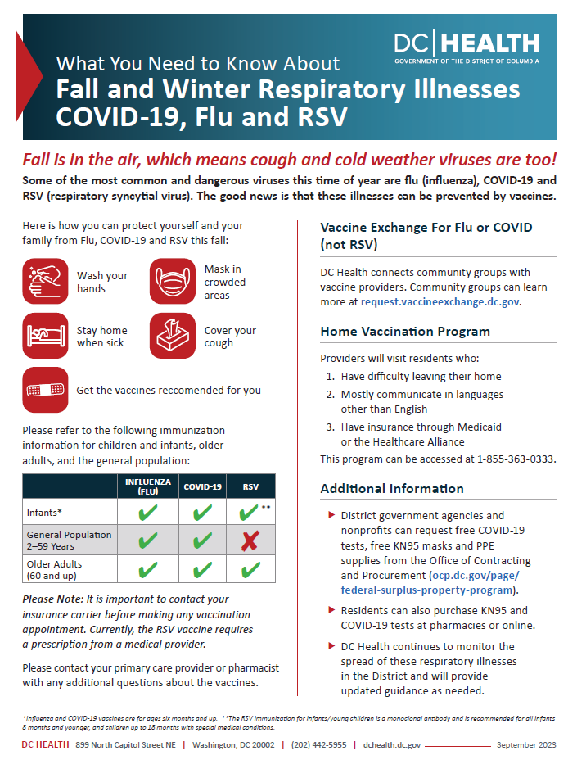
COVID-19 Related Updates
Under §5 for Services, proposed section for COVID-19 & Respiratory Illness integrates
DC Health’s Fall/Winter Plan (see poster)
DHS guidance specific to homeless services
Other protection measures:
24/7 LBS operations at key locations is still in place
References to COVID-19 shelter densities are minimized as shelter densities are up for the locations listed below
PEP-V and ISAQ are no longer referenced in the Plan.
Location | FY23 Capacity | FY24 Capacity
Adam’s Place (men) | 125 | 150
CCNV Drop-In Center (men) | 67 | 134
Emery (men) | 100 | 130
Harriet Tubman (women) | 155 | 165
CCNV 2 South (women) | 24 | 48

Slide 29
OTHER SIGNIFICANT CHANGES

Slide 30
Other Significant Changes
Deployment of Warming Buses (WMATA & HSEMA)
Tested last year based on demand for unsheltered individuals
Well received, so included in the Winter Plan
Expansion of Services
Launch of Front Door Navigation Tool (DHS)
Effort to promote diversion and rapid exit resources
60 clients referred in the first week of launch!
New detoxification providers (DBH)
Previously, the only option was PIW
Can now access services at 2 additional locations (Federal City Recovery Services & Regional Addiction Prevention (RAP) Inc)

Slide 31
CHANGES BY SECTION

Slide 32
Changes by Section
Section | Overview of Changes
Introduction | Tweaked references to COVID-19, MPX, & OMS as appropriate
§2. Process for Calling Alerts | Standard template for communicating updates to operations recommended
§3. Emergency Shelter | Most significant changes captured here Final updates flagged by partners
§4. Transportation Schedule | Minimal changes Final updates flagged by partners
§5. Service Coordination | Alignment with actual activities (e.g., meals) Expansion of key services (e.g., detoxification services available) Final updates flagged by partners
§6. Unaccompanied Minors & TAY | Alignment with actual activities

Slide 33
Introduction
COVID-19 Protection Measures:
Most significant protection still in place is 24/7 operation at most low barrier shelter
References to COVID-19 shelter densities are minimized as shelter densities are slightly up for 5 locations
Location | FY23 Capacity | FY24 Capacity
Adam’s Place (men) | 125 | 150
CCNV Drop-In Center (men) | 67 | 134
Emery (men) | 100 | 130
Harriet Tubman (women) | 155 | 165
CCNV 2 South (women) | 24 | 48
Monkey Pox: references have been removed
OMS: language in the introduction is untouched.

Slide 34
§1. Process for Developing, Publicizing & Updating
1.1 Publicizing the Plan
Adjusted dates to indicate campaign will begin Nov 1, 2023
1.2 Updating the Plan:
Focused role of ERSO on tracking implementation of Winter Plan and providing critical updates.

Slide 35
§2. Process for Calling Alerts
2.3 Communicating Shifts in Operations
Standard templates recommended for communicating shifts in operations related to
Hours for facilities, including Day/Drop-In Centers, LBS, and Overflow shelters
Hours and locations for Warming Buses or other critical infrastructure supports
Transportation Schedule Updates

Slide 36
§3. Emergency Shelter
3.1 Shelter for Individuals: Access, Type, and Hours of Operation
For second year, no seasonal shelters for single adult subsystem
Overflow sites come online when low-barrier shelters are at or near capacity:
Men: a total of 20 vacant beds
Women: a total of 10 vacant beds
3.2 Shelter for Families: Access, Type, and Hours of Operation
Updated information for Virginia Williams

Slide 37
§3. Emergency Shelter
3.3 Estimating Shelter Capacity
Recommendation from Shelter Capacity Workgroup
Table 3: Comparison of TCP Utilization & DHS Forecast Model
Timing | Population | Utilization Data | Forecast Model
Start of Hypo | Men | 1,294 | 1,366
 | Women | 483 | 500
Height of Hypo | Men | 1,350 | 1,419
 | Women | 569 | 549

Slide 38
§3. Emergency Shelter
Facility | Provider | Year- Round | Overflow | Total
Year-Round Locations & Associated Overflow Capacity
801 East Shelter | Catholic Charities | 332 | 40
New York Avenue | Catholic Charities | 225
Adams Place Shelter | Catholic Charities | 150
Emery | Coalition for the Homeless | 130 | 60
Blair | Coalition for the Homeless | 72
Living Life Alternatives (LGBTQ+) | KBEC | 28
Additional Overflow Capacity Available Early in the Season
CCNV Drop-In Center | Community for Creative Non-Violence |  | 134
Salvation Army (Sherman Ave NW) | TBD |  | 40
Church of the Epiphany | TBD |  | 30
Naylor Road | TBD |  | 47
Placeholder | TBD |  | 78
Subtotal (Capacity Available Early Season) |  | 937 | 429 | 1,366
Target Recommended by Shelter Capacity WG (DHS Forecast Model) |  |  |  | 1,366
Overflow Capacity Available Later
Federal City Shelter (CCNV) 1 North | TBD |  | 180
Subtotal (Capacity Available Later in the Season) |  | 937 | 609 | 1,546
Target Recommended by Shelter Capacity WG (DHS Forecast Model) |  |  |  | 1,419
3.3.2 Capacity Needs for Men
Goals:
1,366 beds (start)
1,419 beds (height/max)
Final updates from DHS

Slide 39
§3. Emergency Shelter
Name of Facility | Provider | Year- Round | Overflow | Total
Year-Round Capacity & Associated Overflow
D.C. General Building 9 Harriet Tubman | Catholic Charities | 165
Patricia Handy Swing Space | N Street Village | 140
Saint Josephine Bakhita (formerly Nativity Shelter) | Catholic Charities | 20
Living Life Alternatives (LGBTQ+) | KBEC | 12
Adam’s Place Day Center | DHS |  | 40
Overflow Available Early in the Season
CCNV 2 South | Community for Creative Non-Violence |  | 48
Salvation Army Harbor Light | TBD |  | 40
Faith United Church of Christ | TBD |  | 40
Naylor Road | TBD |  | 47
Subtotal (Plus Overflow Available Early) |  | 337 | 215 | 552
Target Recommended by Shelter Capacity WG (DHS Forecast Model) |  |  |  | 500
Overflow Available Later in the Season
Same as Overflow Available Early in the Season
Total Capacity (Year-Round Plus All Overflow) |  | 337 | 215 | 552
Target Recommended by Shelter Capacity WG (TCP Utilization Analysis) |  |  |  | 569
3.3.2 Capacity Needs for Women
Goals:
500 beds (start)
569 beds (height/max)
Final updates from DHS

Slide 40
§3. Emergency Shelter
3.3.4 Capacity Needs for Families
ERSO Concern:
179 for shelter census on the last day of Sept is too low.
Actual shelter census is 216
ICH Updates:
At 50% surge in entries, need 400 beds by the end of March
At 25% surge in entries, need 300 beds by the end of March.
Currently have 359
Original Model in Draft Winter Plan | Oct 23 | Nov 23 | Dec 23 | Jan 24 | Feb 24 | Mar 24
Families in shelter on last day of previous month | 179 | 192 | 213 | 194 | 195 | 181
(+) Estimated Entries (based on a 2-year average, plus 50% surge) | 116 | 113 | 90 | 98 | 77 | 108
(-) Exits | 72 | 66 | 74 | 61 | 66 | 79
Total Families | 223 | 239 | 229 | 231 | 206 | 210
Updated Model Using Current Shelter Census Data & 50% Surge in Entries | Oct 23 | Nov 23 | Dec 23 | Jan 24 | Feb 24 | Mar 24
Families in shelter on last day of the previous month | 216 | 260 | 307 | 323 | 360 | 371
(+) Estimated Entries (based on a 2-year average, plus 50% surge) | 116 | 113 | 90 | 98 | 77 | 108
(-) Exits | 72 | 66 | 74 | 61 | 66 | 79
Total Families | 260 | 307 | 323 | 360 | 371 | 400
Updated Model Using Current Shelter Census Data & 25% Surge in Entries | Oct 23 | Nov 23 | Dec 23 | Jan 24 | Feb 24 | Mar 24
Families in shelter on last day of previous month | 216 | 241 | 269 | 270 | 291 | 289
(+) Estimated Entries (based on a 2-year average, plus 25% surge) | 97 | 94 | 75 | 82 | 64 | 90
(-) Exits | 72 | 66 | 74 | 61 | 66 | 79
Total Families | 241 | 269 | 270 | 291 | 289 | 300
Documented Availability of Shelter for Families | Units
Short-Term Family Housing Units^{[4]} | 311
Apt Style Units^{[5]} | 48
Total Capacity | 359
^{[4]} Thirty-five units of Short-term Family Housing meet the HSRA definition of “apartment-style.” ^{[5]} This includes the following locations: Park Road (43), and five (5) single family homes operated by Everyone Home DC.

Slide 41
§3. Emergency Shelter
3.4 Warming Buses & Sites
Background:
4 warming buses were deployed last year
Feedback from the community that this was an important intervention
Recommendations:
Maintaining the number of buses deployed last year
Adding a staffing component to address challenges identified last year
Working with Front Door Services monthly to identify hot spots (a prioritized list of potential locations for placing warming buses) is critical

Slide 42
§4. Transportation Schedule
09/27 ERSO Concerns:
What are the limitations of “on-demand” transportation? Is it available 24/7?
Who is the immediate point of contact for escalating concerns with transportation services?
ICH Updates to the Plan:
Limitations listed in a table to address concerns about availability when
Buses are running scheduled routes,
Drivers need breaks, or
Drivers are refueling/cleaning vans.
Contact for Dervin Brown included in the Winter Plan
Final updates flagged by partners:
Need to remove all references to Pat Handy Legacy from the Transportation Plan.
Type | Description | Hours
Scheduled | Direct transportation in the mornings from shelters to specific locations throughout the District and in the evening from those designated pick-up locations back to the shelters. | See details in 4.3 Morning Transportation Schedule (from Single Adult Shelters) 4.4 Afternoon & Evening Transportation Schedule (To Day Centers and Single Adult Shelters
Unscheduled or “on demand” | Provided outside of scheduled transportation hours to assist vulnerable individuals in accessing shelter regardless of the alert status. | Not available for at least 30 mins: before the first scheduled transportation run and after the last scheduled transportation run. Generally, scheduled runs pick up and drop off from 6:30 – 9:30 am, 2 pm, and 4:30 – 8:30 pm. Additionally, breaks for drivers and the need to refuel or clean vans may prevent or delay the immediate provision of on-demand services.

Slide 43
§5. Service Coordination
5.1 Housing Services and Supports, including Front Door Navigation Tool
Housing Services & Supports
Concern that overflow shelters are not adequately supported/connected to CAHP process
Front Door Navigation Tool
Homeless Services Hotline launched in June
Short questionnaire to support Hotline Staff determine if someone is a good candidate for diversion or rapid exit.
Referral to Project Reconnect

Slide 44
§5. Service Coordination
5.2 COVID & Respiratory Illness
General DC Health guidance
Regarding COVID-19, flu, & RSV
Vaccination is key!
DHS Guidance
Masks & antigen tests available
Report positive cases amongst Clients to DHS
Follow CDC guidance for isolation & quarantine on-site (Guidance on Management of COVID-19 in Homeless Service Sites)

Slide 45
COVID-19 Outstanding Concerns & Forum
Areas of concern identified by 09/27 ERSO CMTE meeting include:
Supporting prevention efforts by working with DC Health to ensure vaccines are easily accessible/available to homeless services clients and program staff operating facilities
Providing the latest guidance and updates that address to the safety concerns voiced by homeless services clients and program staff operating facilities
Planning for the safety of individuals that are unlikely to vaccinate
Tracking prevalence of respiratory illnesses, particularly COVID-19, in temporary housing facilities
Understanding vulnerability, including increased mortality related to respiratory illnesses
Preventing transmission in congregate shelter settings, including investigating the appropriate shelter densities to mitigate spread if the prevalence respiratory illnesses and the associated vulnerabilities change significantly during the upcoming hypothermia season
Contingency planning for mass infection events
Forum for tracking and addressing COVID Concerns
If an ICH Health Care Committee is established, it may be most appropriate to refer COVID-19 and respiratory illness related discussions to that forum with updates to the ICH Emergency Response and Shelter Operations Committee (ERSO) as appropriate.
This will allow the ICH ERSO Committee to focus on tracking implementation of the Winter Plan.

Slide 46
§5. Service Coordination
5.3 Meals
Reminder:
Last year, we were hoping for 3 meals per day (as part of 24/7 operations)
Currently serving 2 meals a day (due to funding constraints), so need to align language in Winter Plan to minimize confusion.

Slide 47
§5. Service Coordination
5.5 Mental Health & Detoxification Services
Significant expansion in voluntary detoxification services
Previously, the only option was PIW
Can now access services at 2 additional locations
Federal City Recovery Services &
Regional Addiction Prevention (RAP), Inc.
MPD Role in Transportation
New detox partners offer transportation services
Removing all references to MPD’s role in transportation for voluntary detoxification services.
Final update will remove the following sentence from page 35
“Finally, note that MPD is not responsible for and does not offer transportation for voluntary services.”

Slide 48
§6. Unaccompanied Minors & TAY
Introduction:
Minimized references to Solid Foundation DC
6.1 Unaccompanied Minors (<18 Years of Age)
Removed references to ICH monitoring utilization of beds for minors to align with actual activities
Moved capacity overview (table) for Minors into this section (previously provided under section 6.2)
6.2 TAY (18 – 24 Years Old)
Again, minimized references to Solid Foundation DC
Moved capacity overview (table) for Minors from this section into the appropriate section (moved to section 6.1)
6.3 Outreach & In-Reach Services for Youth
Updated language to reflect the current reality that the Youth CAHP By Name List includes every young adult, regardless of where they are accessing shelter

Slide 49
Notes on Winter Plan Updates
Comments related to the DGS Update:
Rico Harris (CCNV): Request for DGS to also consider repairs to 2 South.
DGS: Confirmation that the current scope of repairs does not include 2 South but that DGS can consider the request and work with CCNV to determine whether it would be appropriate to expand the scope of work to include 2 South.

Slide 50
Notes on Winter Plan Updates
Comments related to COVID:
Kelly McShane (COH): Have heard concerns from women’s service providers that with the closing of ISAQ and PEPV, related to shelter capacity and COVID response.
ICH: The respite beds for women were accommodated at PEPV and as demobilizing PEPV, there may be a question on respite beds for women at a location where women are traditionally served. There are respite beds available at 801 East. In terms of isolation and quarantine, we need to determine what our strategy is as ISAQ was demobilized. It is important that providers do not take action unilaterally but that we have a strategy as a system to implement a response. Grateful for support of DC Health.
DHS: There are respite beds at PEPV Skyline as well as capacity at the Aston once online.
DC Health: It will be an unusual year. The vaccine has rolled out differently than in the past. DC Health is in communication with CDC to ensure adequate supply for clinics and public health locations. There is an expectation that flu and RSV will overlap with COVID again this year. If this is the case, likely does not allow ability to confirm for need of isolation. The best bet is risk mitigation to reduce and prevent so that dramatic isolation is not needed.
Reginald Black: Are our shelter densities within guidelines to reduce spread of COVID?
ICH: Support from DC Health included coverage of efforts in DCPS and to extend those strategies to our community.
DC Health: Will do our best to be as spaced as possible. Public health is about balancing risk.

Slide 51
Notes on Winter Plan Updates
Comments related to DBH services/detox:
DBH: Also, looking forward to stabilization center in the coming weeks/months.
Reginald Black: If the stabilization center comes online mid-season, likely need to add language to the Winter Plan in anticipation of more information.
DBH: Do provide transportation free of charge if there is a need.
MPD: Clarifying that MPD is not responsible for all transportation for voluntary transportation. Recommended removal of reference to MPD for voluntary detox transports as continue to develop policy.

Slide 52
Notes on Winter Plan Updates
Comments related to Transportation:
Karen Cunningham: Do we have data on utilization of the warming buses last season?
ICH: Data is not readily available in this meeting. We review this monthly at the ERSO CMTE and are responsive to feedback regarding hotspots, etc. as much possible.
Comments related to Communications:
Reginald Black: If there is a freeze, or alert before the start of the season on Nov 1, will the plan be activated? Why are we publicizing in the Plan in November? Shouldn’t it be earlier?
ICH: Shift in publicizing the plan was moved to accommodate the timeline for adopting the plan. In terms of communication, we call out the importance on communicating shifts in operations. See slide 35, sections 2.3 of the plan.
Reginald Black: Should be concerned about communities opposing use of rec center for homeless services, not relying on messaging that rec centers are needed for youth programs.
CA: Meet regularly with cohorts of ONSE with lived experience, the most uniform recommendation we hear is use of rec centers and activities. With this funding, we provided additional funds to DPR for weekends and later activities, even some sites open all night. The pivot to planning for capacity without rec centers is recognizing that we can still mobilize for use if needed, but to mobilize a plan that does not rely on rec centers.

Slide 53
Notes on Winter Plan Updates
Comments related to shelter capacity and operations:
OSSE: With the shift in use for Naylor Road, how will family shelter placements and capacity be impacted this hypothermia season? Will families currently at Naylor Road have to move?
DHS: Naylor Road is currently vacant. No families will be relocated.
Kelly McShane: What is the capacity to serve Singles at Naylor Road?
DHS: 134 total capacity at Naylor Rd to accommodate men and women.
Amanda Chesney (Catholic Charities): What is the breakdown for men and women at the CCNV drop-in center versus Women’s 2 South?
Reginald Black: We are classifying addtl capacity as overflow. Is it 24/7? Do we need to call out difference in hours of operation?
ICH: It is called out in the plan that overflow sites operate 7pm – 7am.
Amanda Chesney: Once the overflow sites open during the season do they remain open or are they alert night?
ICH: The way it is written in the plan, looked at utilization data to see if ability to consolidate and if we have the resources online. Last year, never got below the numbers to take an overflow site offline, but monitor this throughout the season.
DHS: Once the overflow sites open, they are open for the season unless there is a significant issue such as maintenance, building issue, etc.

Slide 54
Notes on Winter Plan Updates
Comments related to shelter capacity for individuals:
Reginald Black: Regarding women’s capacity, the main concern have heard is about location. Specifically, need to look at services and shelter locations available downtown.
DHS: Our success is not whether or not our forecast is precise, it is that we have a level of readiness and are prepared and actively serving as well as working through contingencies. DHS monitors shelter dashboard in detail. Centered on reducing exposure to cold weather injury. DHS has the demonstrated capabilities to expand as needed and meet demand. Working to add beds within the system shortly.
Reginald Black: 134 at Naylor Rd. How do you trigger the distribution of beds for men vs women?
DHS: Naylor Rd will have beds for men and women. Intend to operate it similar to how have operated co-ed shelters in the past. Expect a breakdown of 70/30, but will accommodate whoever needs a bed there. Breakdown will be based on who needs a bed, so need to operate with some flexibility.
Amanda Chesney: Clarification Blair house is Catholic Charities, not Coalition. Bakhita expands by 5 beds in hypo season.
Kate Coventry: Shout out to ICH and DHS for the work on the plan, in support! Do not know that the larger shelter contingencies are as desirable as the smaller rec centers, so would be good to monitor utilization and feedback via ERSO CMTE in real time.
ICH: Can leverage ERSO CMTE and it’s WGs to monitor this as well as how queues at shelter are managed. Between the CMTE and WGs there should be a meeting every two weeks that allows us to monitor utilization and feedback at a regular cadence.

Slide 55
Notes on Winter Plan Updates
Comments related to Shelter Capacity and Migrants/OMS:
DBH: Are we anticipating any surge in need based on the number of migrants passing through and/or remaining in the District? How are we addressing that issue?
DHS: Migrant families are accommodated through OMS and temporary lodging for families. Individuals are served through LBS, though not collecting information related to migrant status in HMIS as matter of practice. Have estimates on use of system but want to understand more.

Slide 56
Notes on Winter Plan Updates
Comments related to shelter capacity for families:
OSSE: What is Plan B if there is a surge above 50%?
ICH: We have at least 3 months of capacity to respond to this scenario per the model. Additionally, the model is conservative because the District has the demonstrated capability to ramp up exits as entries increase. It is likely that we can accommodate surges above 50% with current capacity.
DHS: Since we have had year-round access to shelter since 2016 for families, we have not seen the same kind of seasonal spikes in placements. Our length of stay is low and exceeding our benchmarks. DHS has other apt-style shelters with space, so not in any way concerned that we are reaching the limit in capacity. We will monitor this in the year ahead, but feel confident that we are prepared to serve families in existing capacity.
Karen Cunningham: Everyone Home DC has 4 apt style shelter units, not 5. Correction to be made in footnote.

Slide 57
Notes on Winter Plan Updates
Comments related to daytime hypothermia and cold weather alerts:
Dr. Crosland: Requesting clarity on difference between hypo alerts and cold weather alerts. What additional resources go into effect with alerts?
ICH: The right to shelter is related to inclement weather events which is why we are tracking hypothermia alerts, but we are mobilizing overflow sites to meet demand for the duration of hypothermia season with the onset of the first alert event. Due to the risk of cold weather injury, we also mobilize overnight warming sites and warming buses.
CA: Plan A is the proposed Winter Plan. Plan B and C is working with DHS and DGS to continue to identify additional locations and capacity. Rec centers are available as a last resort. If in the event Plan A is inadequate for what we are seeing, then we activate rec centers on alert nights based on previous experience.
Dr. Crosland: Request for clarity on whether sites will remain open for the duration of daytime hypothermia and cold weather alerts.
DHS: Low barrier year-round shelters remain 24/7. Overflow shelters will be open 7p-7a unless there is a daytime or a cold weather emergency alert, they will be open 24/7.
ICH: We can update the plan to reflect this.
Amanda Chesney: Are there plans or other operations to stay on for example holidays, etc.
ICH: That has never been noted in the plan and has been worked out separately by site and occasion.
Christy Respress: This confusion highlights importance of marketing and communication!!
Reginald Black: Can say something like “facilities will open if x” or “if alert is called”.

Slide 58
Notes on Winter Plan Updates
Comments related to FD-12:
Kate Coventry: Question on change in language page 36, third bullet in middle of the page of tracked changes document. “When an FD-12…”
ICH: Clarification was that 911 is the proper course of action to secure appropriate needs.
MPD: Transport is not entirely based upon observation of the behavior. Will rely on observance of provider. If on its face there is no basis, will shift response. Nothing is changing in these operations. There has been some litigation recently so will continue to review this and prefer leaving it out if decision needs to be made. Want to assure we are here to help and will continue to assist. Rely on OUC that alerts the proper party.
ICH: Request for clarification to reinstate that language in the final plan. Invite to MPD for the next ERSO CMTE for more context on this.
DBH: In a mental health crisis, 988 should be called as opposed to 911.
ICH: Access Helpline and Crisis response is also included in the plan.

Slide 59
Meeting Agenda
Welcome and Opening Remarks (5 mins)
Public Comments (20 mins)
Discussion on Adopting a Winter Plan (60 mins)
Background/Basics of the Plan (10 mins)
Understanding the Updates to the Winter Plan (30 mins)
Action (Consensus or Vote) to Adopt (10 mins)
The Future of Hypothermia Planning (10 mins)
Public Comments Continued (time permitting)
Summary & Adjournment (5 mins)

Slide 60
Action (Consensus or Vote) to Adopt
Seeking Consensus
Calling for a Vote (if necessary)

Slide 61
Roll Call & Vote
DC Gov Count 16
Quorum = 1/3rd of 16
Count | Government Representatives | Present | Vote
1 | City Administrator, Chair
2 | Deputy Mayor for Health and Human Services
3 | Interagency Council on Homelessness
4 | Department of Human Services
5 | Department of Behavioral Health
6 | Child and Family Services Agency
7 | Department of Housing and Community Development
8 | Department of Health
9 | DC Housing Authority
10 | Department of Corrections
11 | Department of Employment Services
12 | Office of the State Superintendent of Education
13 | Homeland Security and Emergency Management Agency
14 | Department of General Services
15 | DC Metropolitan Police
16 | Office of LGBTQ Affairs
Subtotal of Gov Reps
Quorum (Defined as 1/3 of 16 = 5.33) |  | 6 | N/A

Slide 62
Roll Call & Vote
Service Provider
Count 6
Quorum = 1/3rd of 6
 | Category | Name | Present | Vote
1 | Provider | Christy Respress, Pathways
2 | Provider | Ishan Heru, Community Connections
3 | Provider | Jean-Michel Giraud, Friendship Place
4 | Provider | Koube Ngaaje, DASH
5 | Provider | Amanda S Chesney, Catholic Charities
6 | Provider | Kelly S McShane, Community of Hope
7 | Provider | Kenyatta T Brunson, N Street Village
Subtotal of Providers
Quorum (Defined as 1/3 of 6 = 2) |  |  | 2

Slide 63
Roll Call & Vote
All Other Voting Categories (Advocates, Business Sector & Lived Experience Representatives)
Count 10
Quorum = 1/3rd of 10
 | Category | Name | Present | Vote
1 | Advocate | Adam Rocap, Miriam’s Kitchen
2 | Advocate | Debby Shore, Sasha Bruce Youthworks
3 | Advocate | Karen Cunningham, Everyone Home DC
4 | Advocate | Kate Coventry, DC Fiscal Policy Institute
5 | Business Sector | Tonia Wellons, Great Washington Community Foundation
6 | Business Sector | Catherine Crosland, Unity Healthcare
7 | Business Sector | Shellon Fraser, National Housing Trust
8 | Lived Experience | Aaron White, ICH SHY Youth Advisory Board
9 | Lived Experience | Qaadir El-Amin
10 | Lived Experience | Reginald Black
Subtotal of Advocates, Business Sector & Lived Experience Constituents
Quorum (Defined as 1/3 of 10 = 3.3) |  |  | 4

Slide 64
Notes on Action to Adopt Winter Plan
Does anybody present object to adopting the plan by consensus?
No objections.
The FY24 Winter Plan is adopted.

Slide 65
Notes on Winter Plan Updates
Additional Copy Line Edits and Clarifications Offered Pre and Post Meeting to ICH Staff
Nicole Lee-Mwandha (OSSE):
Noting line edit for “HER Resiliency” in Young Adult Section of the Winter Plan.
Clarifying whether OSSE no longer provides warming buses. Was a footnote in an old version of the plan so want to ensure it is no longer included.
Amanda Chesney: Not required to report positive COVID cases (since May). That may have been a hold over from last year.
Jarroda Kelsaw: If concerns about theft in the shelter, encourage people to take pictures of belongings if they have a phone or staff to take pictures to send to client email. Have heard challenges when clients report to security, a way to show them proof from before.
Annemarie Cuccia: Can include a tearaway sheet (1-2 pages) regarding hypo season shelters, transportation, etc. in the center of the 11/08 issue of Street Sense. Need information by 11/01 from ICH/DHS in order to include in the issue.
ICH Policy on Copy Line Edits
Thank you to our partners for ensuring the accuracy of the District’s Winter Plan by providing your feedback and recommendations! We are grateful for your attention and support.
We will evaluate whether these are technical amendments and updates we can incorporate to the Winter Plan (e.g., edits to confirm how things work) or rather feedback that we can forward to CMTE for discussion (e.g., feedback to consider as committees debrief on the planning process and pivot to seasonal check-ins to gather feedback on implementation).
ICH Full Council and CMTE Members, as you review the proposed copy edits, if you have any strong preferences, priorities feedback or recommendation, do not hesitate to let us know.

Slide 66
Meeting Agenda
Welcome and Opening Remarks (5 mins)
Public Comments (20 mins)
Discussion on Adopting a Winter Plan (60 mins)
Background/Basics of the Plan (10 mins)
Understanding the Updates to the Winter Plan (30 mins)
Action (Consensus or Vote) to Adopt (10 mins)
The Future of Hypothermia Planning (10 mins)
Public Comments Continued (time permitting)
Summary & Adjournment (5 mins)

Slide 67
Future of Hypothermia Planning
Lessons learned
Potential for minimizing swings in system capacity

Slide 68
Notes on Future of Hypo Planning
…

Slide 69
Meeting Agenda
Welcome and Opening Remarks (5 mins)
Public Comments (20 mins)
Discussion on Adopting a Winter Plan (60 mins)
Public Comments Continued (time permitting)
Summary & Adjournment (5 mins)

Slide 70
Summary & Adjournment
Reminder re ICH Full Council Call for Nominations
Next meeting date
Meetings are quarterly, so January is likely next meeting
Proposed agenda
Formalizing proposed ICH Health Care Committee
Adopting an Annual Update
Closing reflections/remarks

Slide 71
ICH: Full Council Call for Nominations
Purpose: Process for official membership as a community representative on the ICH Full Council convened quarterly.
Background: Four (4) categories of voting members represent the community, and the following seats are vacant or expiring across the four categories:
2 advocate seats to represent organizations that advocate for the District’s homeless population;
2 business/private sector seats to represent organizations that have resources or expertise to contribute to addressing homelessness in the District;
2 lived experience seats to represent homeless or formerly homeless individuals;
5 service provider seats to represent organizations providing services within the District’s Continuum of Care for homeless services.
Details: Click here for the Nomination Submission Form open until 10/20! Self-nominations only, please.

Slide 72
Notes on Summary & Adjournment
…

